Slide 1
Scientific Programming
Introduction
Ankara University
Computer Engineering Department

Slide 2
MATLAB
Scientific Computing
Interactive Calculation
Programming
Graphics
Animation
and more…

Slide 3
MATLAB
MATrix LABoratory
Software Package for high-performance numerical computation and visualization
Own high-level programming language
External Interface to run Fortran and C programs

Slide 4
MATLAB
Optional Toolboxes
Toolboxes are collections of functions written for special applications such as
  Symbolic Computation
  Image Processing
  Statistics
  Control System Design
  Neural Networks

Slide 5
MATLAB ENVIRONMENT
MATLAB windows
  Command window
  Edit window
  Graphics window

Slide 6
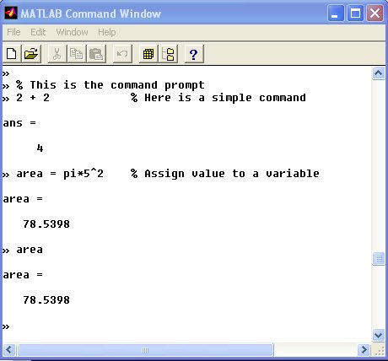
Command Window

Slide 7
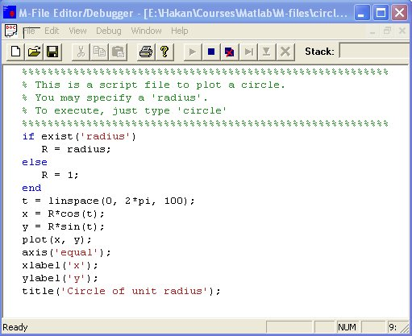
EDIT WINDOW

Slide 8
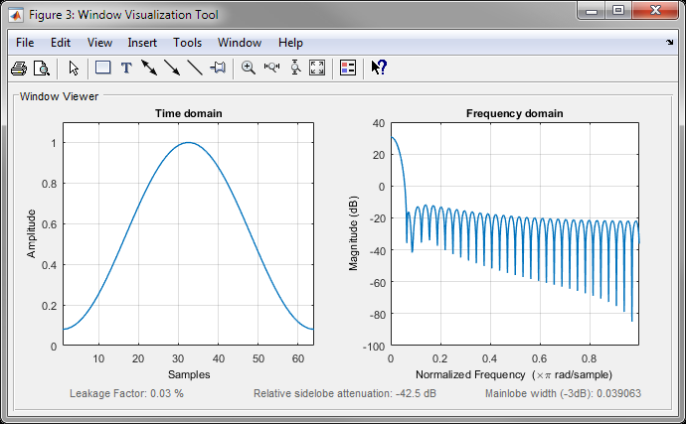

GRAPHICS (FIGURE) WINDOW

Slide 9
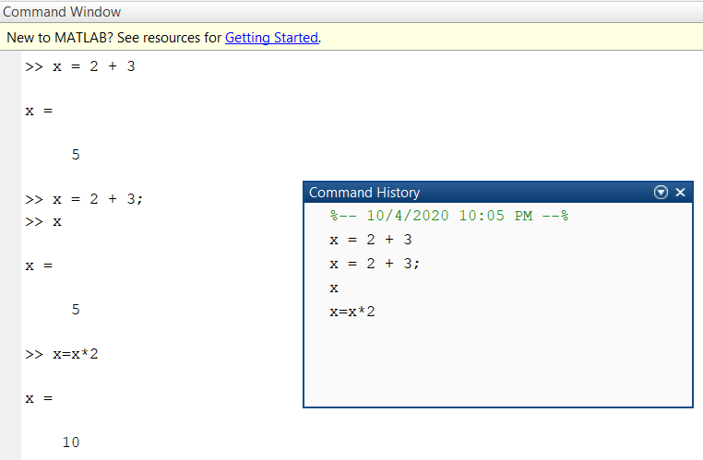
Command History
MATLAB saves previously typed commands in a buffer.
Commands can be recalled with the up-arrow key.

Slide 10
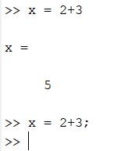
Remarks
Comments: MATLAB takes anything following a % as a comment and ignores it.
(;) A semicolon at the end of a command suppresses the screen output, although the result is saved in the variable ans.

Slide 11
MATLAB
Matrix is the basic building block
Fundamental data-type is the array
Vectors, scalars, real and complex matrices are special cases of basic data type
Built-in functions are optimized for vector operations
Hence vectorized commands or codes run much faster

Slide 12
Dimensioning
Dimensioning is automatic.
No dimension statements are required for vectors or arrays
Use ‘size’ and ‘length’ (vectors only) to find dimension of an existing matrix

Slide 13
Variable Naming
Names must begin with a letter
After the first letter, any number of digits or underscores may be used
But MATLAB remembers only the first 19 characters
MATLAB differentiates between the lowercase and uppercase letters.
A and a are different variables.

Slide 14
Output format
format short 31.4159
format short e 3.1416e+01
format long 31.41592653589793
format long e 3.141592653589793e+01
format short g 31.416
format long g 31.4159265358979
format hex 403f6a7a2955385e
format rat 3550/113
format bank 31.42
...

Slide 15
Long commands
If your command does not fit on one line you can continue the command on the next line if you type three consecutive periods at the end of the line.
Length limit is 4096 characters
» 2 + ...
2
ans =
4
»

